Slide 1
PREDICTING DEFAULTERS ON CREDIT CARDS USING CLASSIFICATION ALGORITHMS
WQD170075 Mathavan Chandrasegaram
WQD7005 Data Mining
Milestone4
Semester 2 2019/2020

Slide 2
Introduction
Given a dataset of n months of payment information, the task is to classify and predict the status of the credit card users (defaulter or non-defaulter), for the incoming n+1 month.
Objectives
To implement 6 types of classifier machine learning algorithms, namely logistic regression, decision tree, naive bayes, random forest, neural networks, and ensemble (AdaBoost).
To implement dimensionality reduction using Principal Component Analysis (PCA) and identify machine learning algorithms that benefit the most from dimensionality reduction of our dataset.
To analyze the best and worst performing classifier suitable for the dataset case.

Slide 3



Introduction
Dataset
UCI Machine Learning Repository
[http://archive.ics.uci.edu/ml/datasets/default+of+credit+card+clients]
3000 instances (observations)
24 attributes (features): personal details, payment history, bill statement, prev. payment
The default payment will be the target (class) of interest
Domain
Classification task (for learning) and the outcome is used as a model to predict whether the client are more likely to default or not for next month payment.

Slide 4


Methods
Implementation approach?
Logistic Regression
Decision Tree
Naive Bayes
Random Forest
Neural Network
AdaBoost
Text-based programming tool (Python) as our primary tool for analytics and machine learning
Visual programming tool (Orange) to plan out our workflow

Slide 5
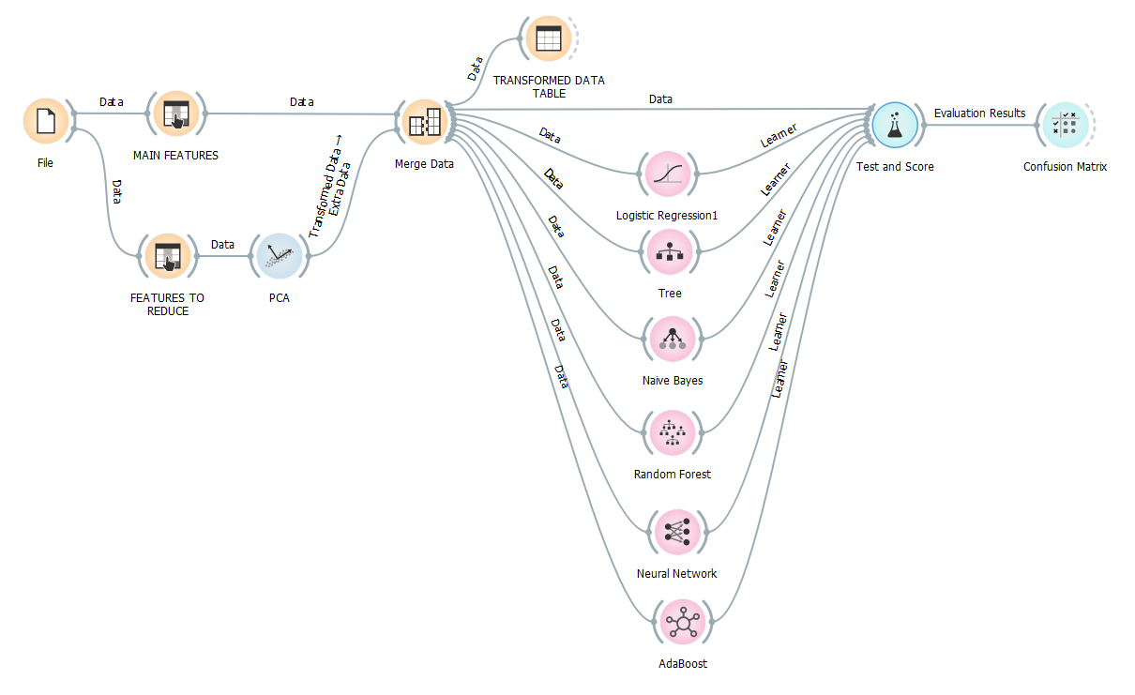
Workflow
Our workflow was drafted using a node-based data mining tool called Orange.
This workflow was later implemented in Python using an ipython notebook.

Slide 6
Methods - Data Input
Download dataset as spreadsheet file, and call the data in Python
Directly retrieve the dataset from online source from Python
Dataset = pd.read_excel('https://archive.ics.uci.edu/ml/machine-learning-databases/00350/default%20of%20credit%20card%20clients.xls',skiprows=1)

Slide 7
Methods - Data Preprocessing
ID int64
LIMIT_BAL int64
SEX int64
EDUCATION int64
MARRIAGE int64
AGE int64
PAY_0 int64
...
PAY_6 int64
BILL_AMT1 int64
...
BILL_AMT6 int64
PAY_AMT1 int64
...
PAY_AMT6 int64
default payment next month int64
dtype: object
ID int64
LIMIT_BAL int64
SEX category
EDUCATION category
MARRIAGE category
AGE int64
PAY_0 category
...
PAY_6 category
BILL_AMT1 int64
...
BILL_AMT6 int64
PAY_AMT1 int64
...
PAY_AMT6 int64
DEFAULT category
dtype: object
All integer values are also normalized to ensure that models requiring normalized values can be trained properly.

Slide 8
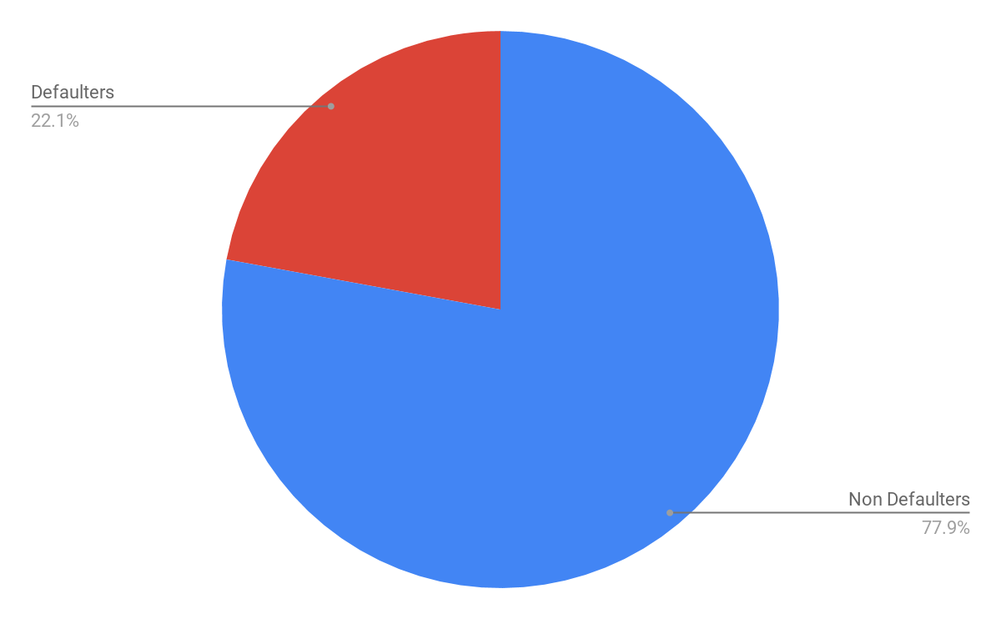
Defaulters VS Non-Defaulters
The distribution of defaulters and non defaulters are unbalanced
Our models are weighted (where applicable) and weighted scoring is used on F1, precision and recall scores

Slide 9
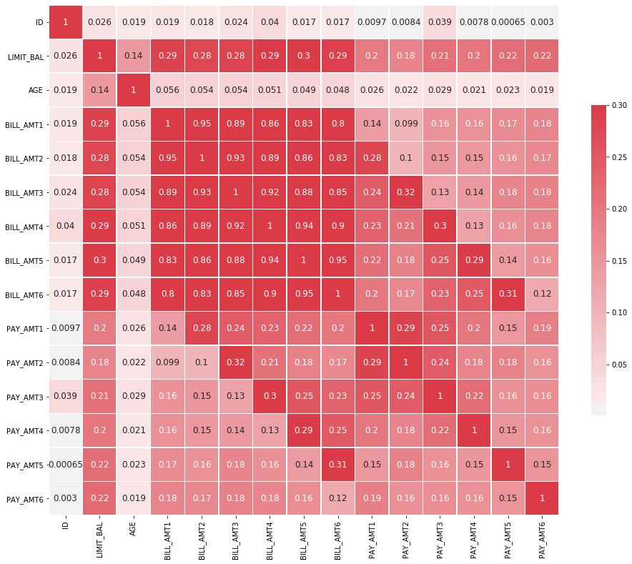
Methods - PCA
Using a correlation heatmap, a cluster of 18 attributes with high correlation is identified:
PAY_0 to PAY_6:
History of past payment
(April to September, 2005)
BILL_AMT1 to BILL_AMT6:
Amount of bill statement
(NT dollar, April to September, 2005)
PAY_AMT1 to PAY_AMT6:
Amount of previous payment
(NT dollar, April to September, 2005)

Slide 10
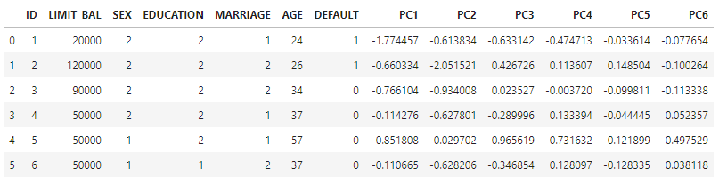
Methods - PCA
Principal Component Analysis
The 18 attributes containing payment and bill details are selected to be reduced to 6 principal components (PC)
The 6 PC are combined with the other attributes in the dataset

Slide 11
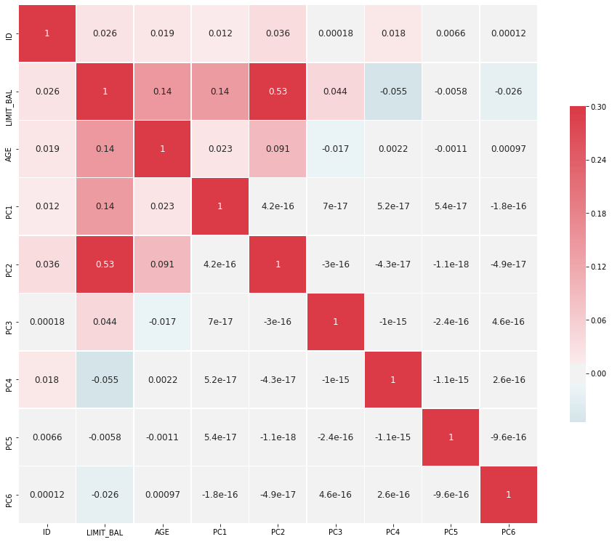
Methods - PCA
The dimensionally reduced dataset does not contain a large number of highly correlated attributes

Slide 12
Methods - Data Sampling
Feature Selection
Scaling
Cross Validation
(5 folds)
Dimensionality Reduction (PCA)
Cross Validation
(5 folds)

Slide 13
Methods - Data Modelling
Logistic Regression | classifier = LogisticRegression()
Decision Tree | classifier = DecisionTreeClassifier(max_depth=10, random_state=14)
Naive Bayes | classifier = GaussianNB()
Random Forest | classifier = RandomForestClassifier(n_estimators=10)
Neural Network | classifier = MLPClassifier(hidden_layer_sizes=(10, 8,6),activation='relu',solver='adam', alpha=0.0001,max_iter=1000)
AdaBoost | classifier = AdaBoostClassifier(learning_rate=0.5, n_estimators=100,algorithm='SAMME.R')

Slide 14
Methods - Evaluation
Area under ROC is the area under the receiver-operating curve.
Classification Accuracy (CA) is the proportion of correctly classified examples.
F-1 is a weighted harmonic mean of precision and recall
Precision is the proportion of true positives among instances classified as positive
Recall is the proportion of true positives among all positive instances in the data
Time - the amount of time (seconds) it takes to complete 5 folds of cross validation

Slide 15
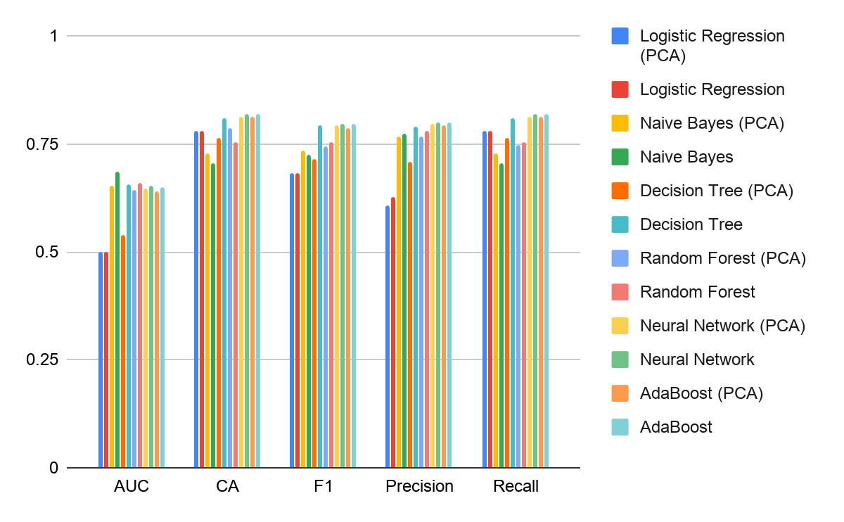
Results - Performance and Score of Each Model

Slide 16
Method | Feature Reduction | AUC | CA | F1 | Precision | Recall | Time (s)
Logistic Regression | PCA | 0.5000 | 0.7788 | 0.6819 | 0.6065 | 0.7788 | 0.97
 | - | 0.5001 | 0.7788 | 0.6821 | 0.6287 | 0.7788 | 4.59
Naive Bayes | PCA | 0.6528 | 0.7290 | 0.7350 | 0.7675 | 0.7290 | 0.23
 | - | 0.6861 | 0.7053 | 0.7255 | 0.7744 | 0.7053 | 0.37
Decision Tree | PCA | 0.5381 | 0.7651 | 0.7152 | 0.7074 | 0.7651 | 1.14
 | - | 0.6566 | 0.8084 | 0.7917 | 0.7895 | 0.8084 | 1.83
Random Forest | PCA | 0.6435 | 0.7879 | 0.7437 | 0.7685 | 0.7461 | 3.58
 | - | 0.6604 | 0.7556 | 0.7539 | 0.7791 | 0.7556 | 4.92
Neural Network | PCA | 0.6479 | 0.8142 | 0.7920 | 0.7959 | 0.8142 | 42.35
 | - | 0.6537 | 0.8177 | 0.7962 | 0.8005 | 0.8177 | 56.24
AdaBoost | PCA | 0.6410 | 0.8117 | 0.7879 | 0.7922 | 0.8117 | 14.34
 | - | 0.6500 | 0.8179 | 0.7949 | 0.8008 | 0.8179 | 21.19

Slide 17
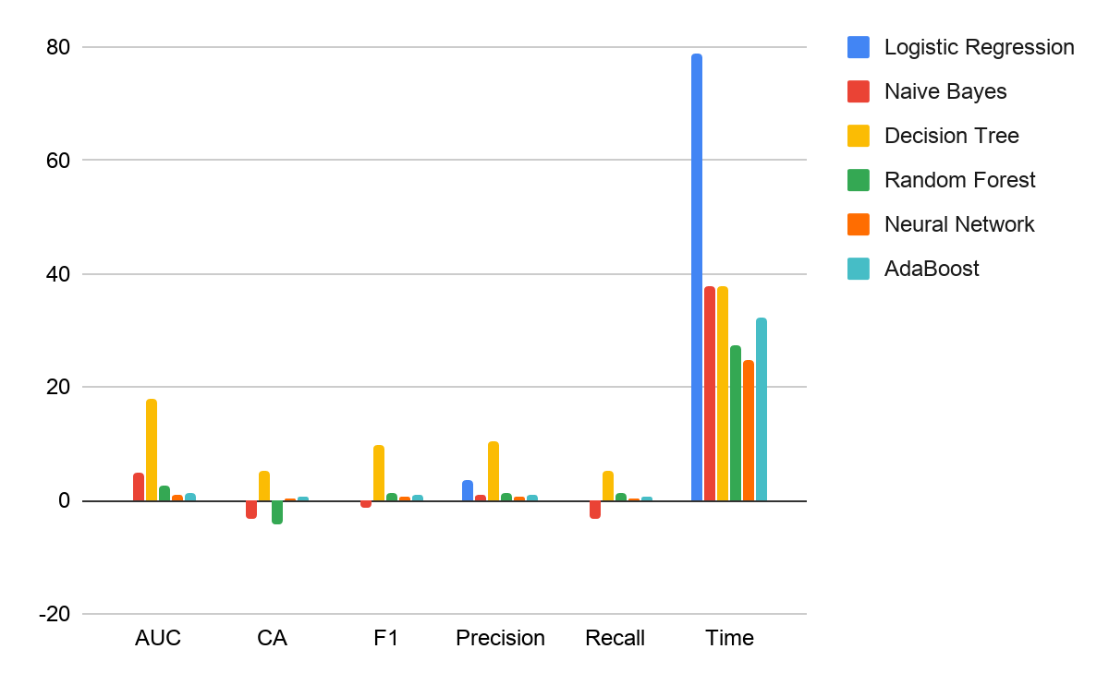
Results - % Reduction in Scores and Training Time
An algorithm that benefits greatly from dimensionality reduction is one which has a high reduction in training time but a low reduction in the scoring metrics.

Slide 18
Conclusion
Best Scores - Artificial Neural Network
Worst Scores - Logistic Regression
Best Improvement (time) using PCA - Logistic Regression
Best Improvement (score) using PCA - Naive Bayes
Least improvement (time) using PCA - Artificial Neural Network
Worst impacted (score) using PCA - Decision Tree

Slide 19
guide
For the Group Project Presentation, please use the followings as a guide:
1. ✓Title page, list of group members with matric numbers
2. ✓Introduction, objectives, dataset, domain
3. ✓Literature review (optional) - show list of 2 journal papers related to the scope after year 2010
4. Methods - each member focus on their method during program development; put more focus on this part
5. Experiment - results analysis, compare results of different methods; show graphs/charts; put more focus on this part
6. Conclusion - additional info to share; go the extra mile
7. ✓Ensure each slide has slide numbering, easy to read font type/size/color
focus on analysis of experiment results; identify contribution of each group members.

Slide 20
Literature Review
[1] H. Admel, K. Dinao, & M. Zerina. (2018). Application of Machine Learning Algorithms In Credit Card Default Payment Prediction. International Journal of Scientific Research, 7(10), 425-426.
Retrieved from https://www.researchgate.net/publication/328026972_Application_of_Machine_Learning_Algorithms_in_Credit_Card_Default_Payment_Prediction
[2] L. Ruilin. (2018). Machine Learning Approaches to Predict Default of Credit Card Clients. Modern Economy, 09(11):1828-1838.
Retrieved from https://www.researchgate.net/publication/328986410_Machine_Learning_Approaches_to_Predict_Default_of_Credit_Card_Clients
[3] S. A. Akanksha & R Manoj. (2019). Prediction of Default Credit Card Users Using Data Mining Techniques. International Journal of Innovative Technology and Exploring Engineering (IJITEE), 8(7), 816-821.
Retrieved from https://www.ijitee.org/wp-content/uploads/papers/v8i7/G5754058719.pdf

